Slide 1
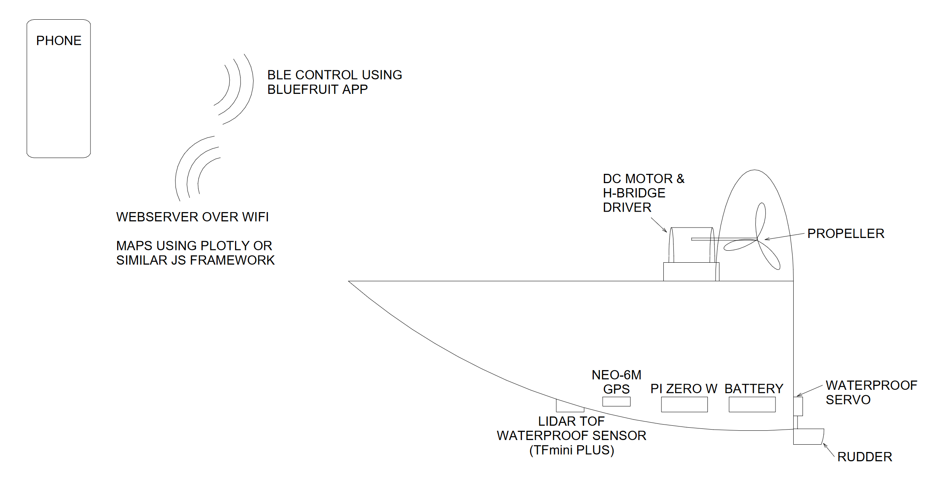
AIRBOAT 4180
Bluetooth controlled airboat with GPS and LiDAR to topographically map lake floors.
Designed by Zachary Mathews

Slide 2
Parts
Aluminum Paint Tray
Waterproof Glue
CanaKit Raspberry Pi Zero W Kit
(2) 5V/2A Portable Chargers
USB Type A to Mini B USB Mini-B Breakout (5V/2A)
H-Bridge Dual TB6612FNG Motor Driver
Brushless DC Motor
Waterproof Servo
Waterproof TFmini Plus Li-DAR
NEO-6M GPS Module
USB to TTL Adapter

Slide 3
Software
PIGPIO was the IO library of choice -> software PWM
Developed serial class to handle Bluetooth and GPS signals
Developed motor class to handle motor startup and control
Developed servo class to handle motor positioning
Developed simple IO class to provide operator overloading for PWM and digital pins
Multithreaded

Slide 4
Web Interface
Uses Plotly Javascript Graphing library to draw 3D topographical surface plot
Yet to test it on water, waiting until after in-person demo

Slide 5
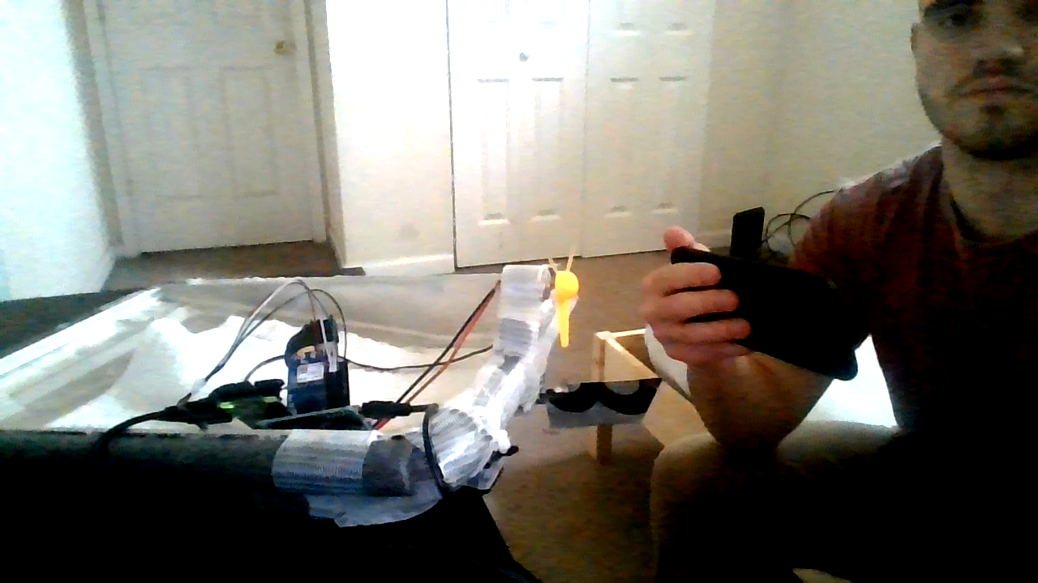

Slide 6
Future Work
Handle motor inrush current
Kills LiDAR and GPS comms
Can probably do it with software
Ignore noise in gyro measurements
Design custom PCB in the same layout as protoboard
Flesh out the website
Allow for more than one data log to be mapped
Write code to wait for Bluetooth connection and GPS fix before running the mapping program
Run code at boot

